Slide 1
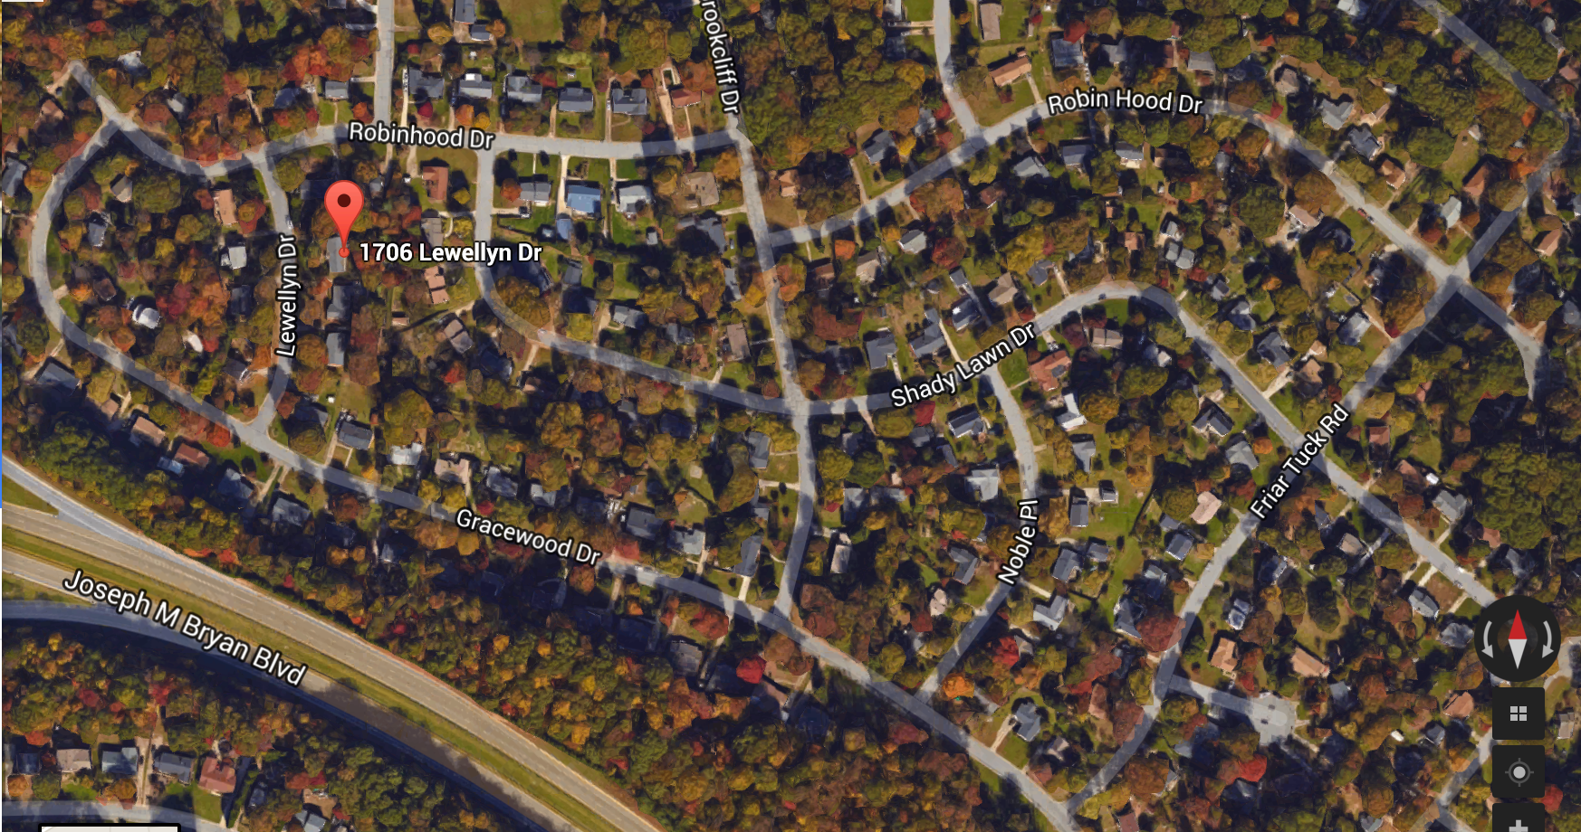
Erin Nicole Poindexter
a life history through place

Slide 2
With art education and human development in mind, I aim to draw your eyes and ears to a few key concepts:
attention, exploration and connection to your environment
the importance of being a “maker” and building confidence in your abilities
investment in your community

Slide 3
Connection to ones environment can be achieved with careful attention and playful exploration.

Slide 4
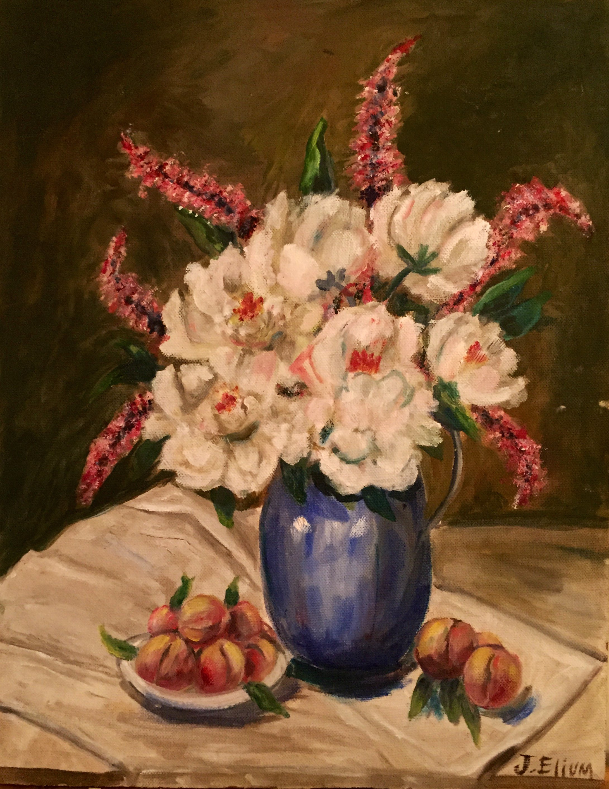
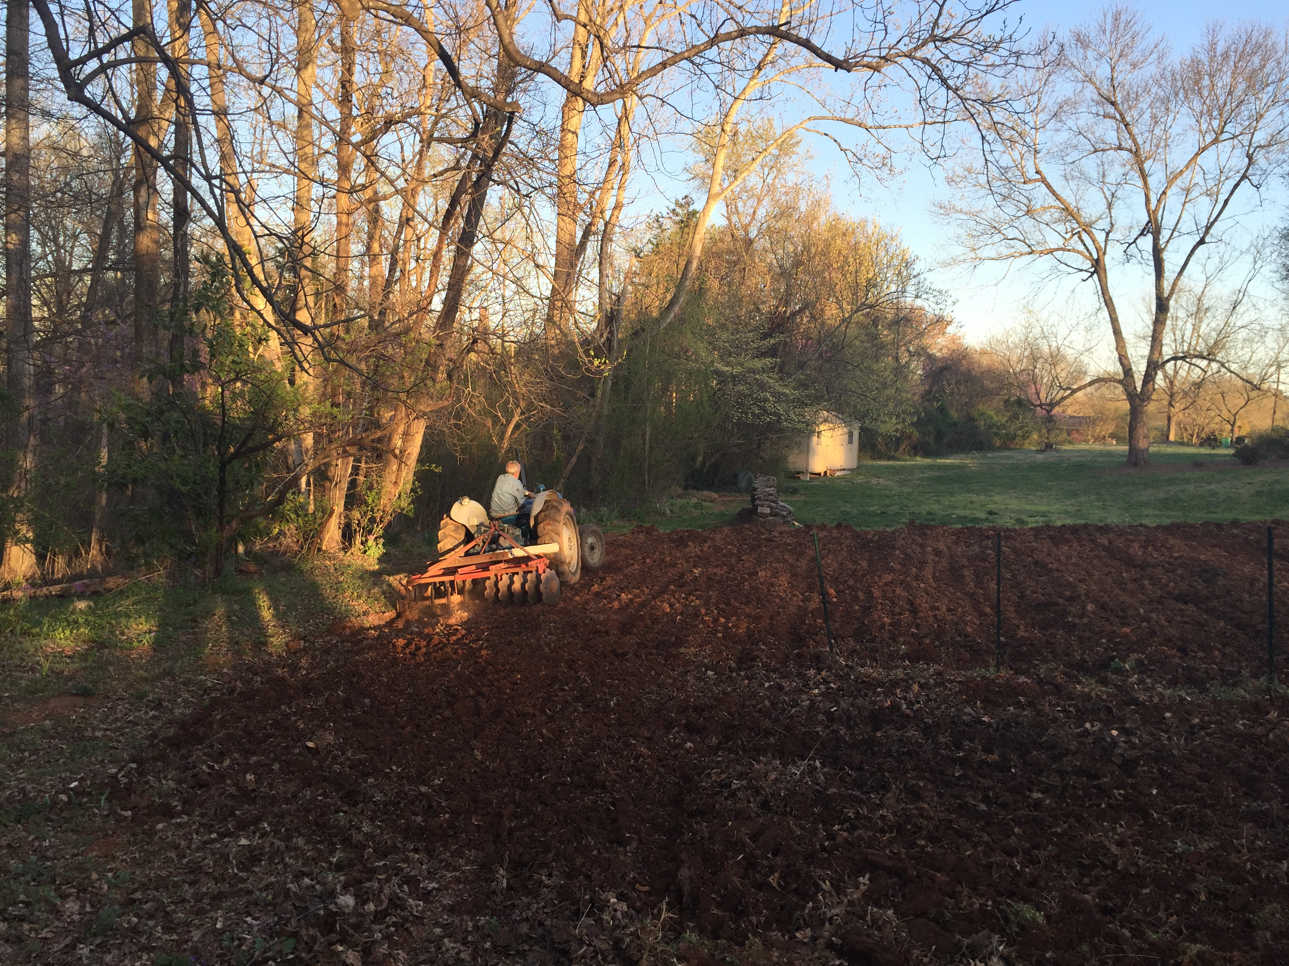
The practice of making builds confidence in your abilities and care to form.

Slide 5
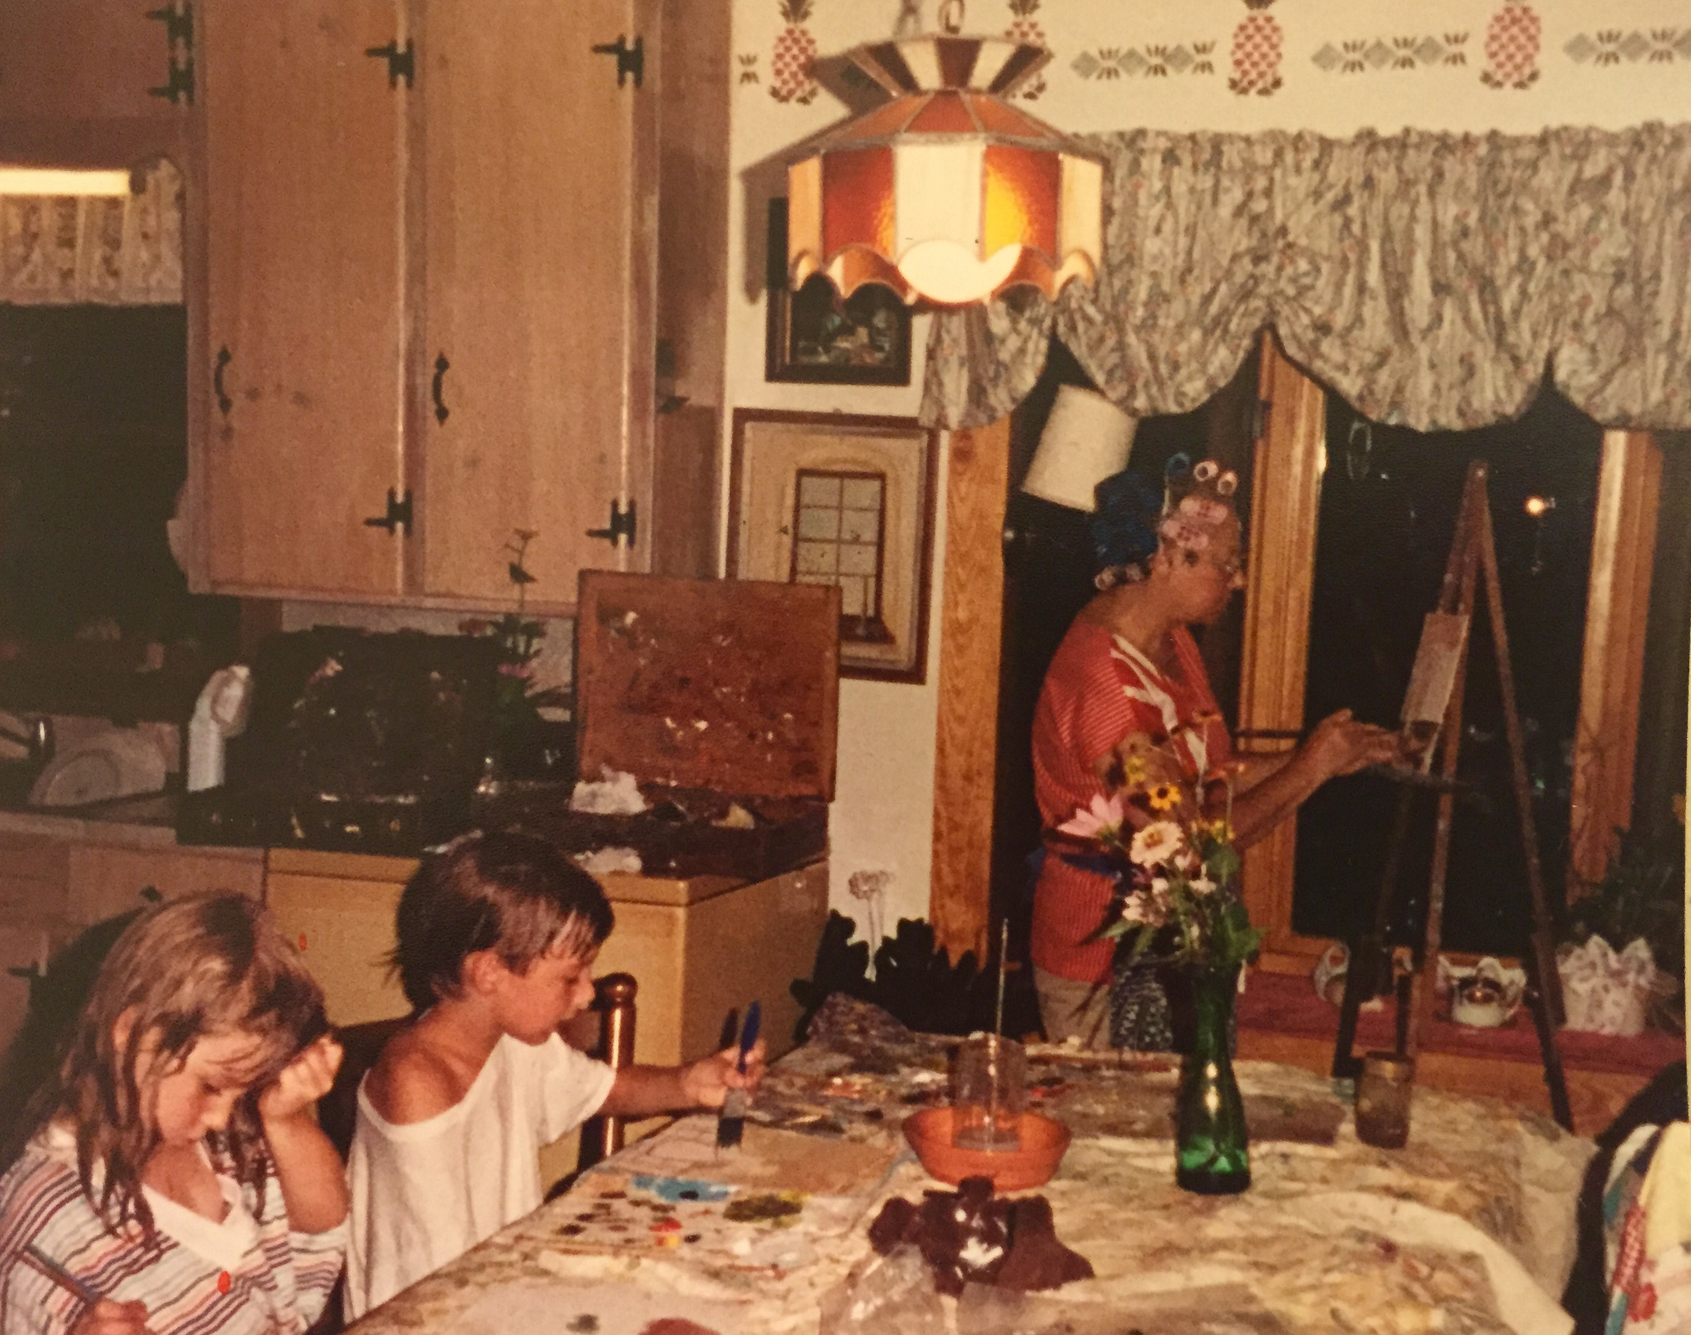
Erin, Justin, and Grandmother painting, 1991

Slide 6
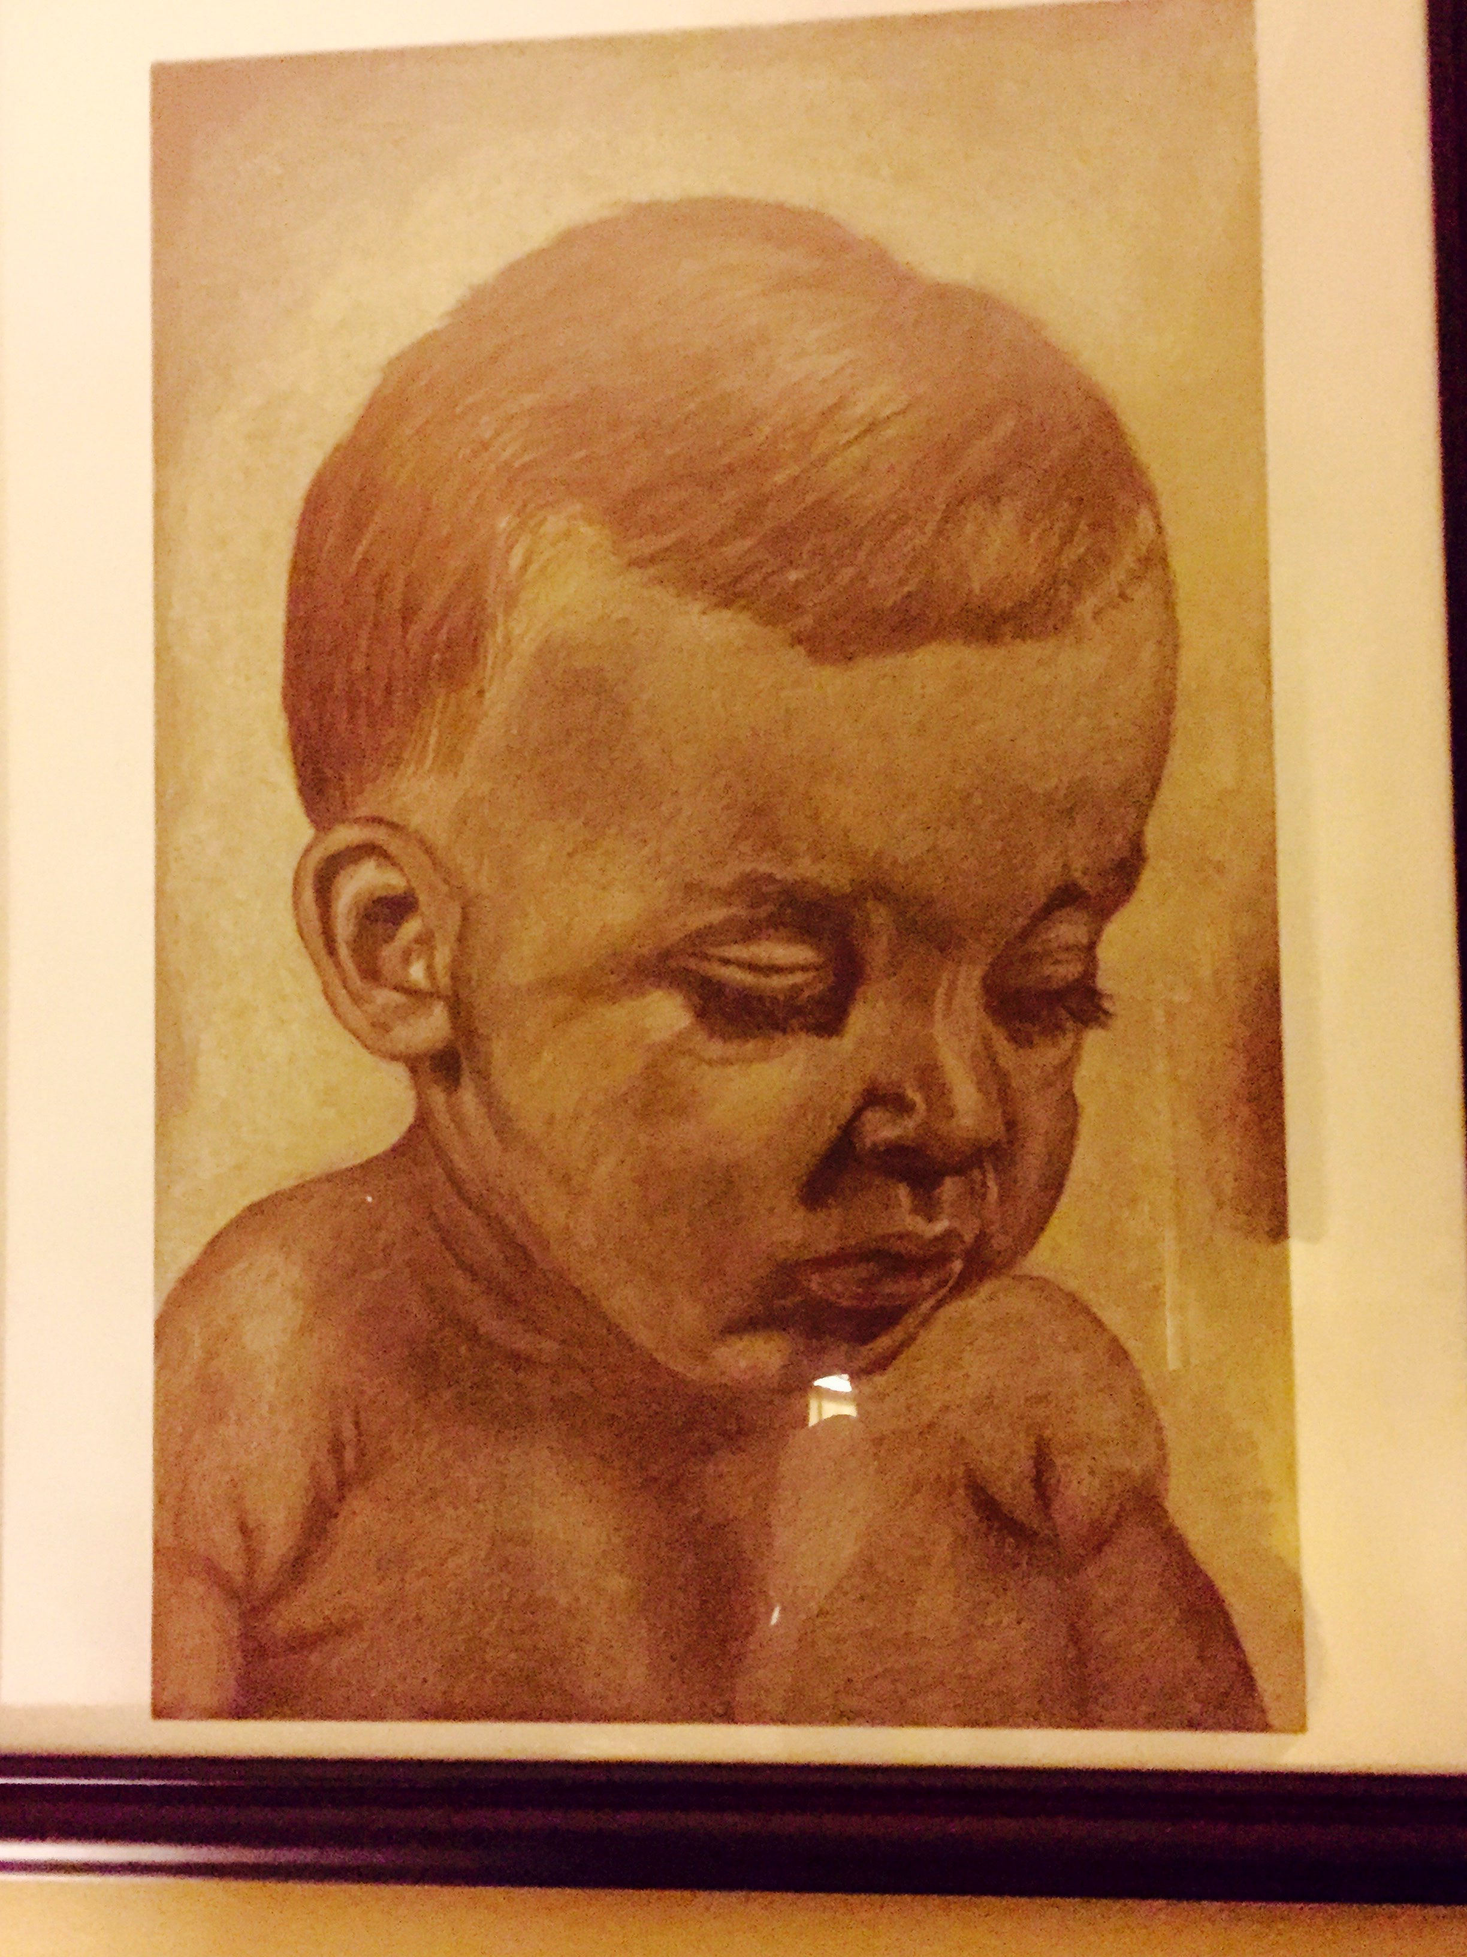
Art is a language. My environment and the people in it are a resource for inspiration.

Slide 7
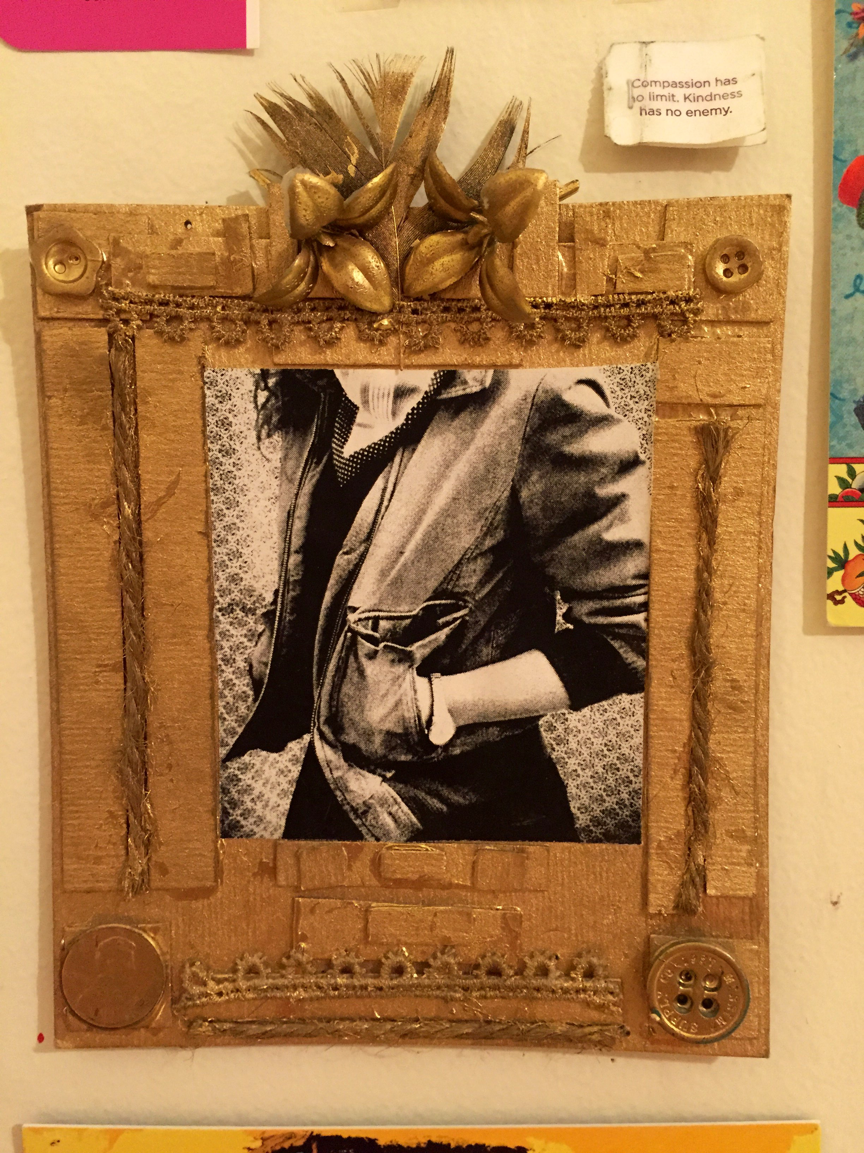
“Marcus and I walked the 8 blocks from Daisy-A-Day, past Washington Park where we once witnessed the bittersweet burial of a family dog. Hidden among the trees in silent participation, we mouthed the words as they sang ‘Amazing Grace’ in unison.” (excerpt “Untitled” 2012)

Slide 8
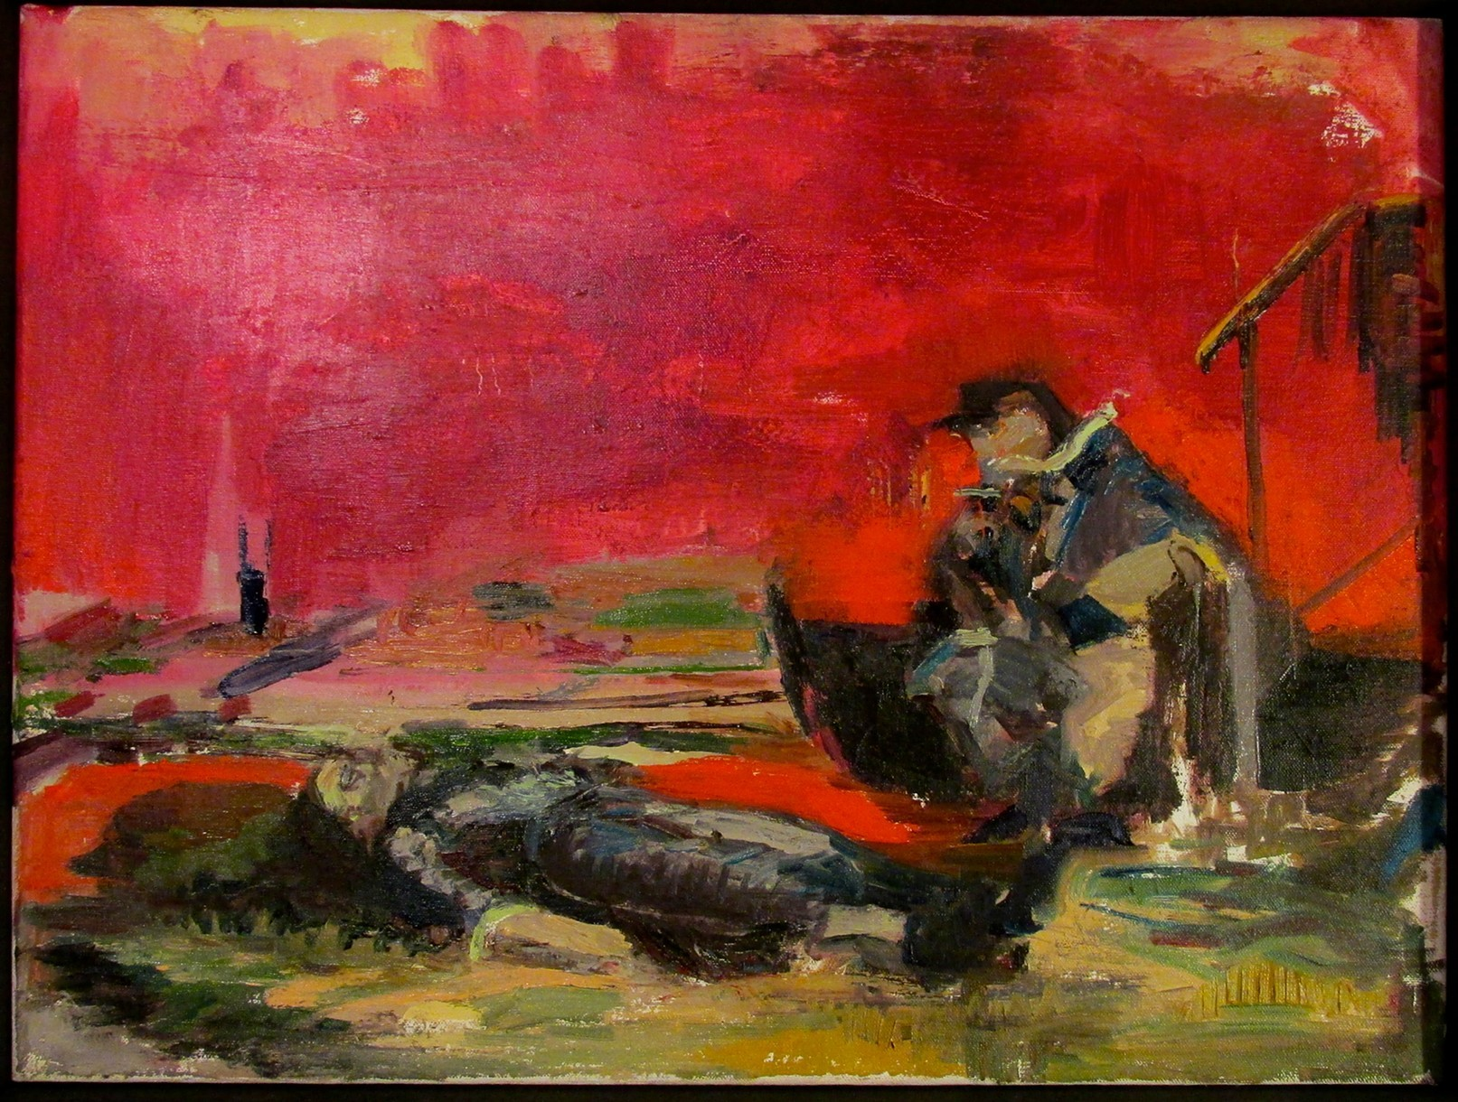
The Old Man and The Sea, 2010

Slide 9
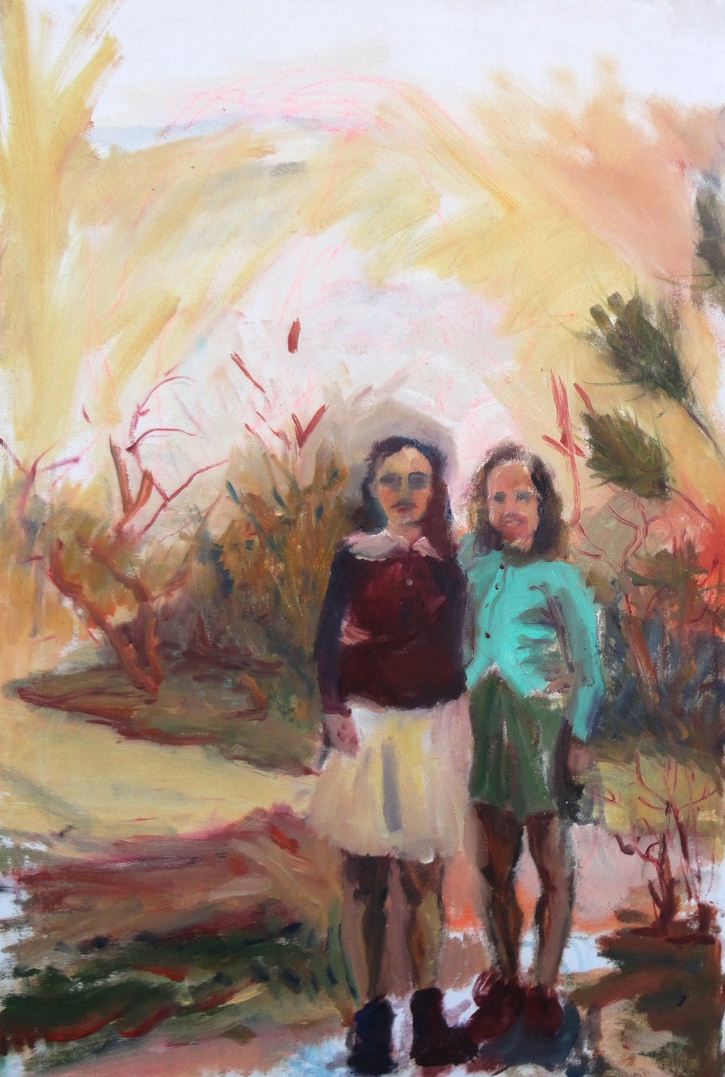
Edie and Fran, 2011

Slide 10
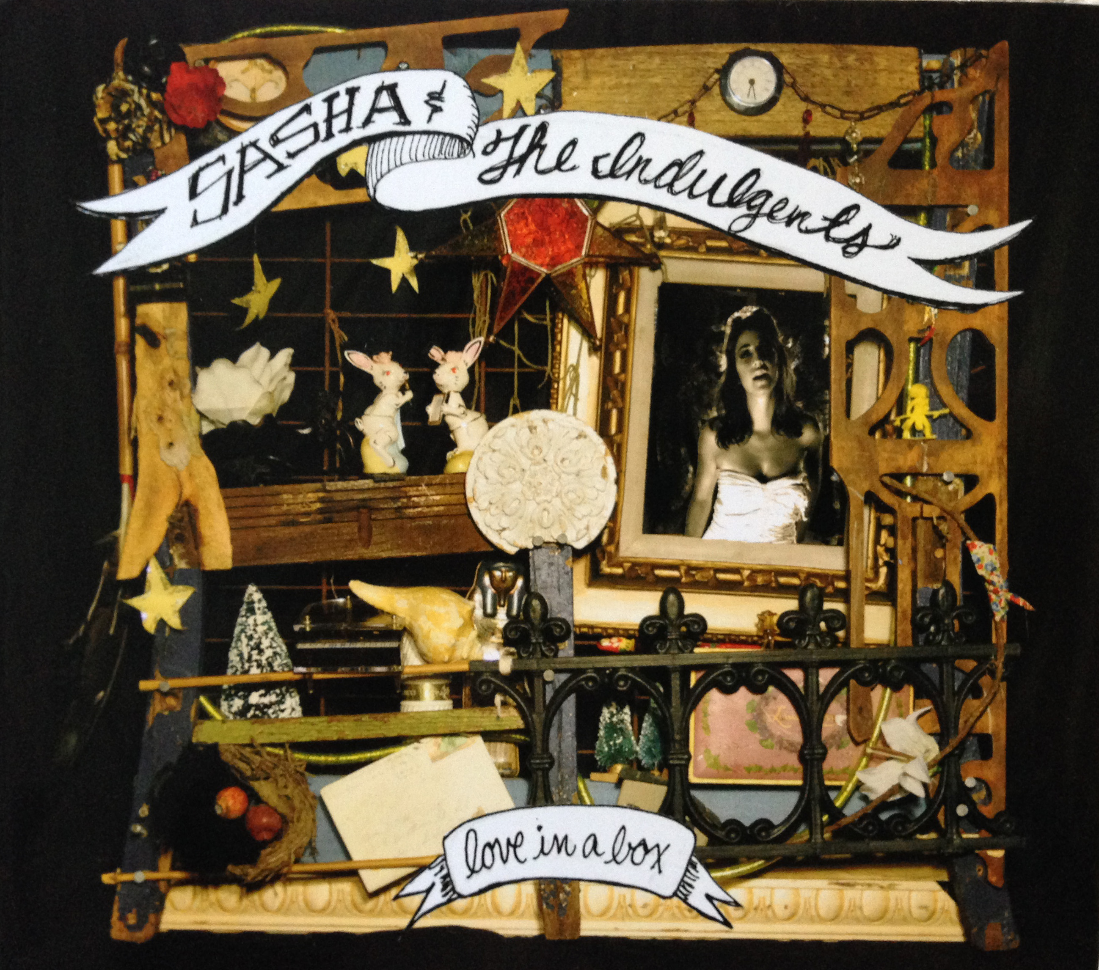
Album cover, 2010

Slide 11
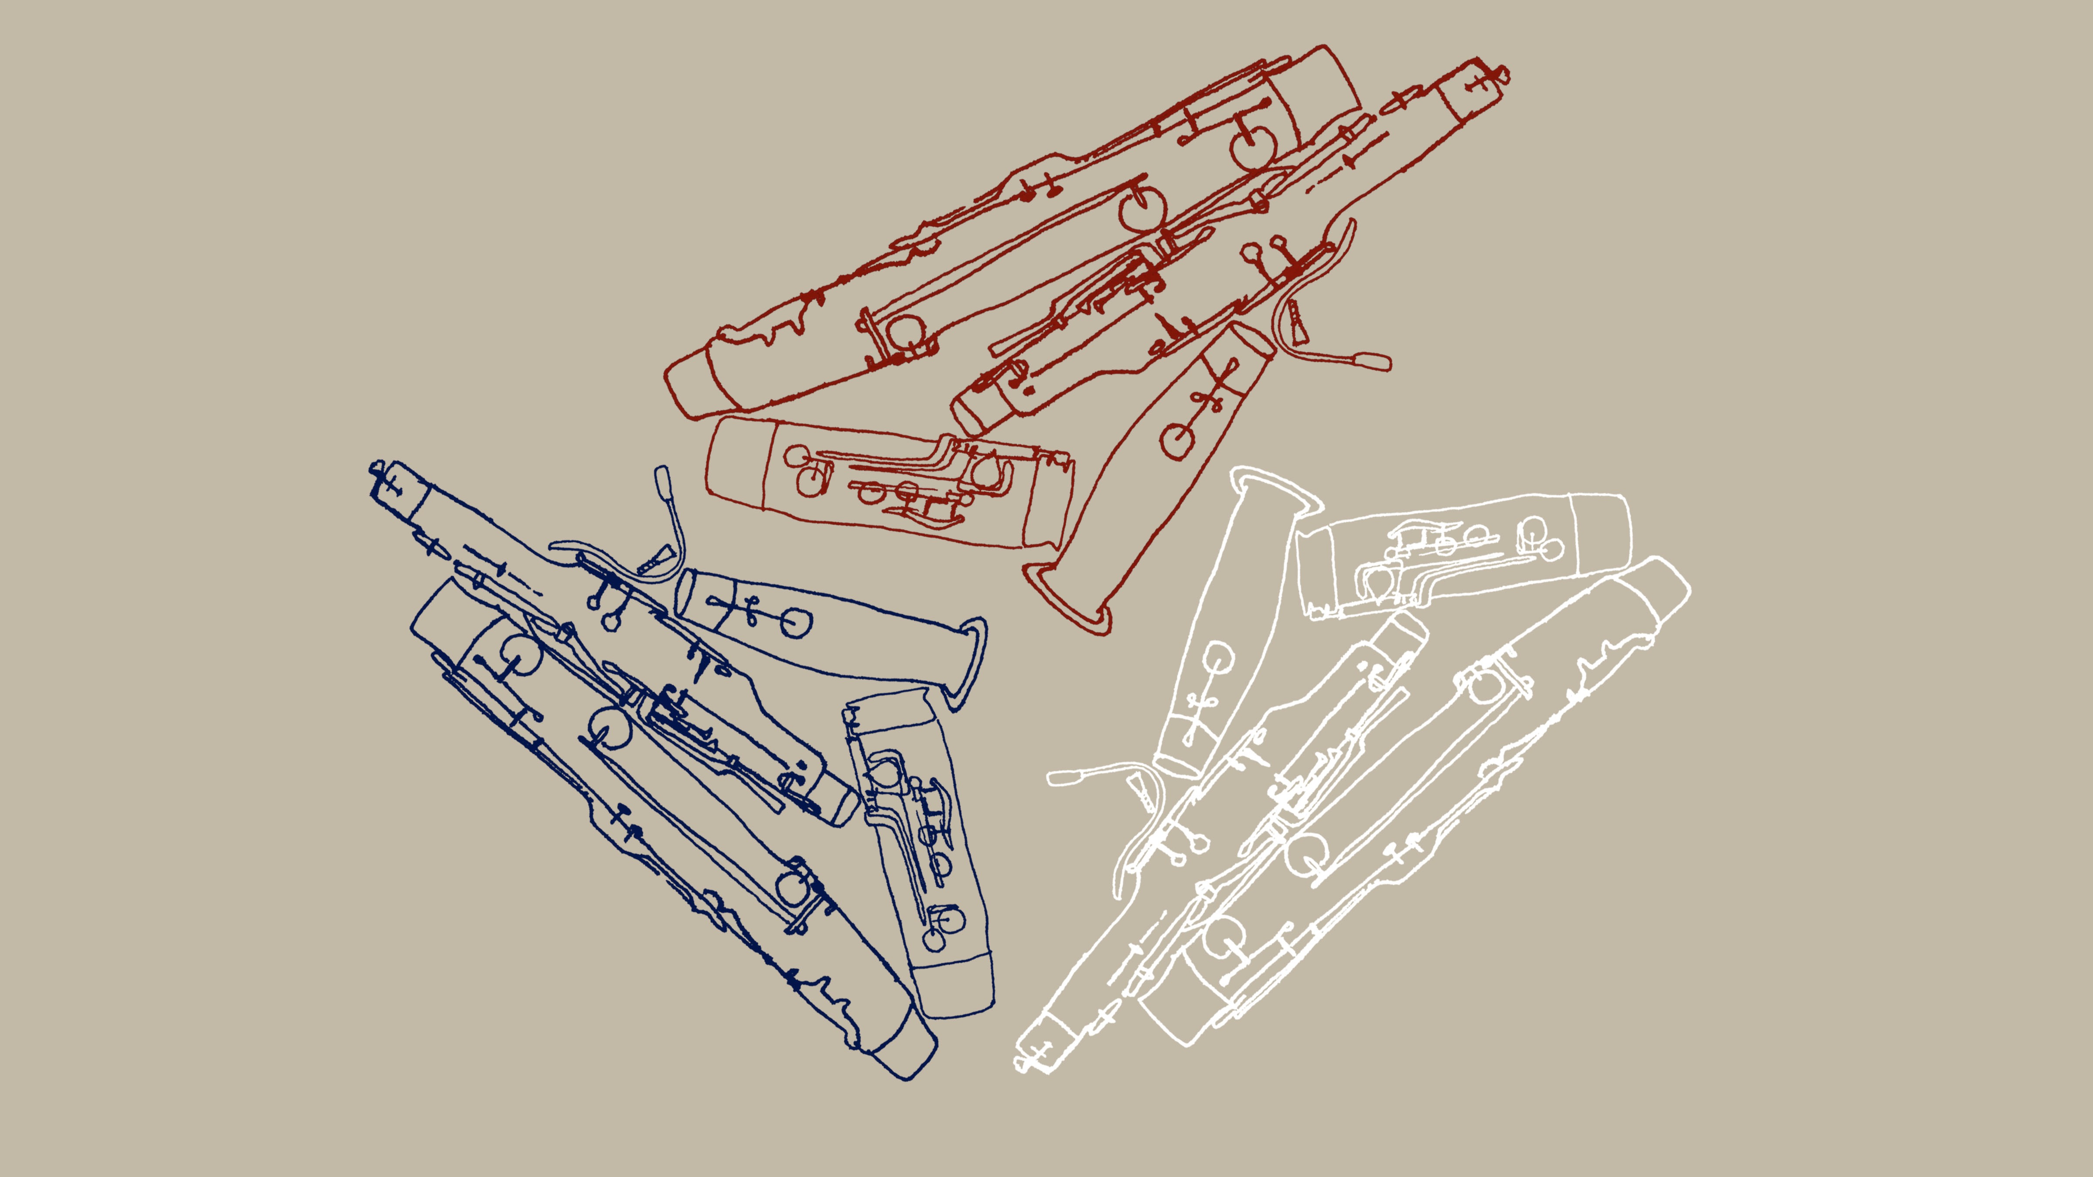
Chris Watford Bassoon Logo, 2014

Slide 12
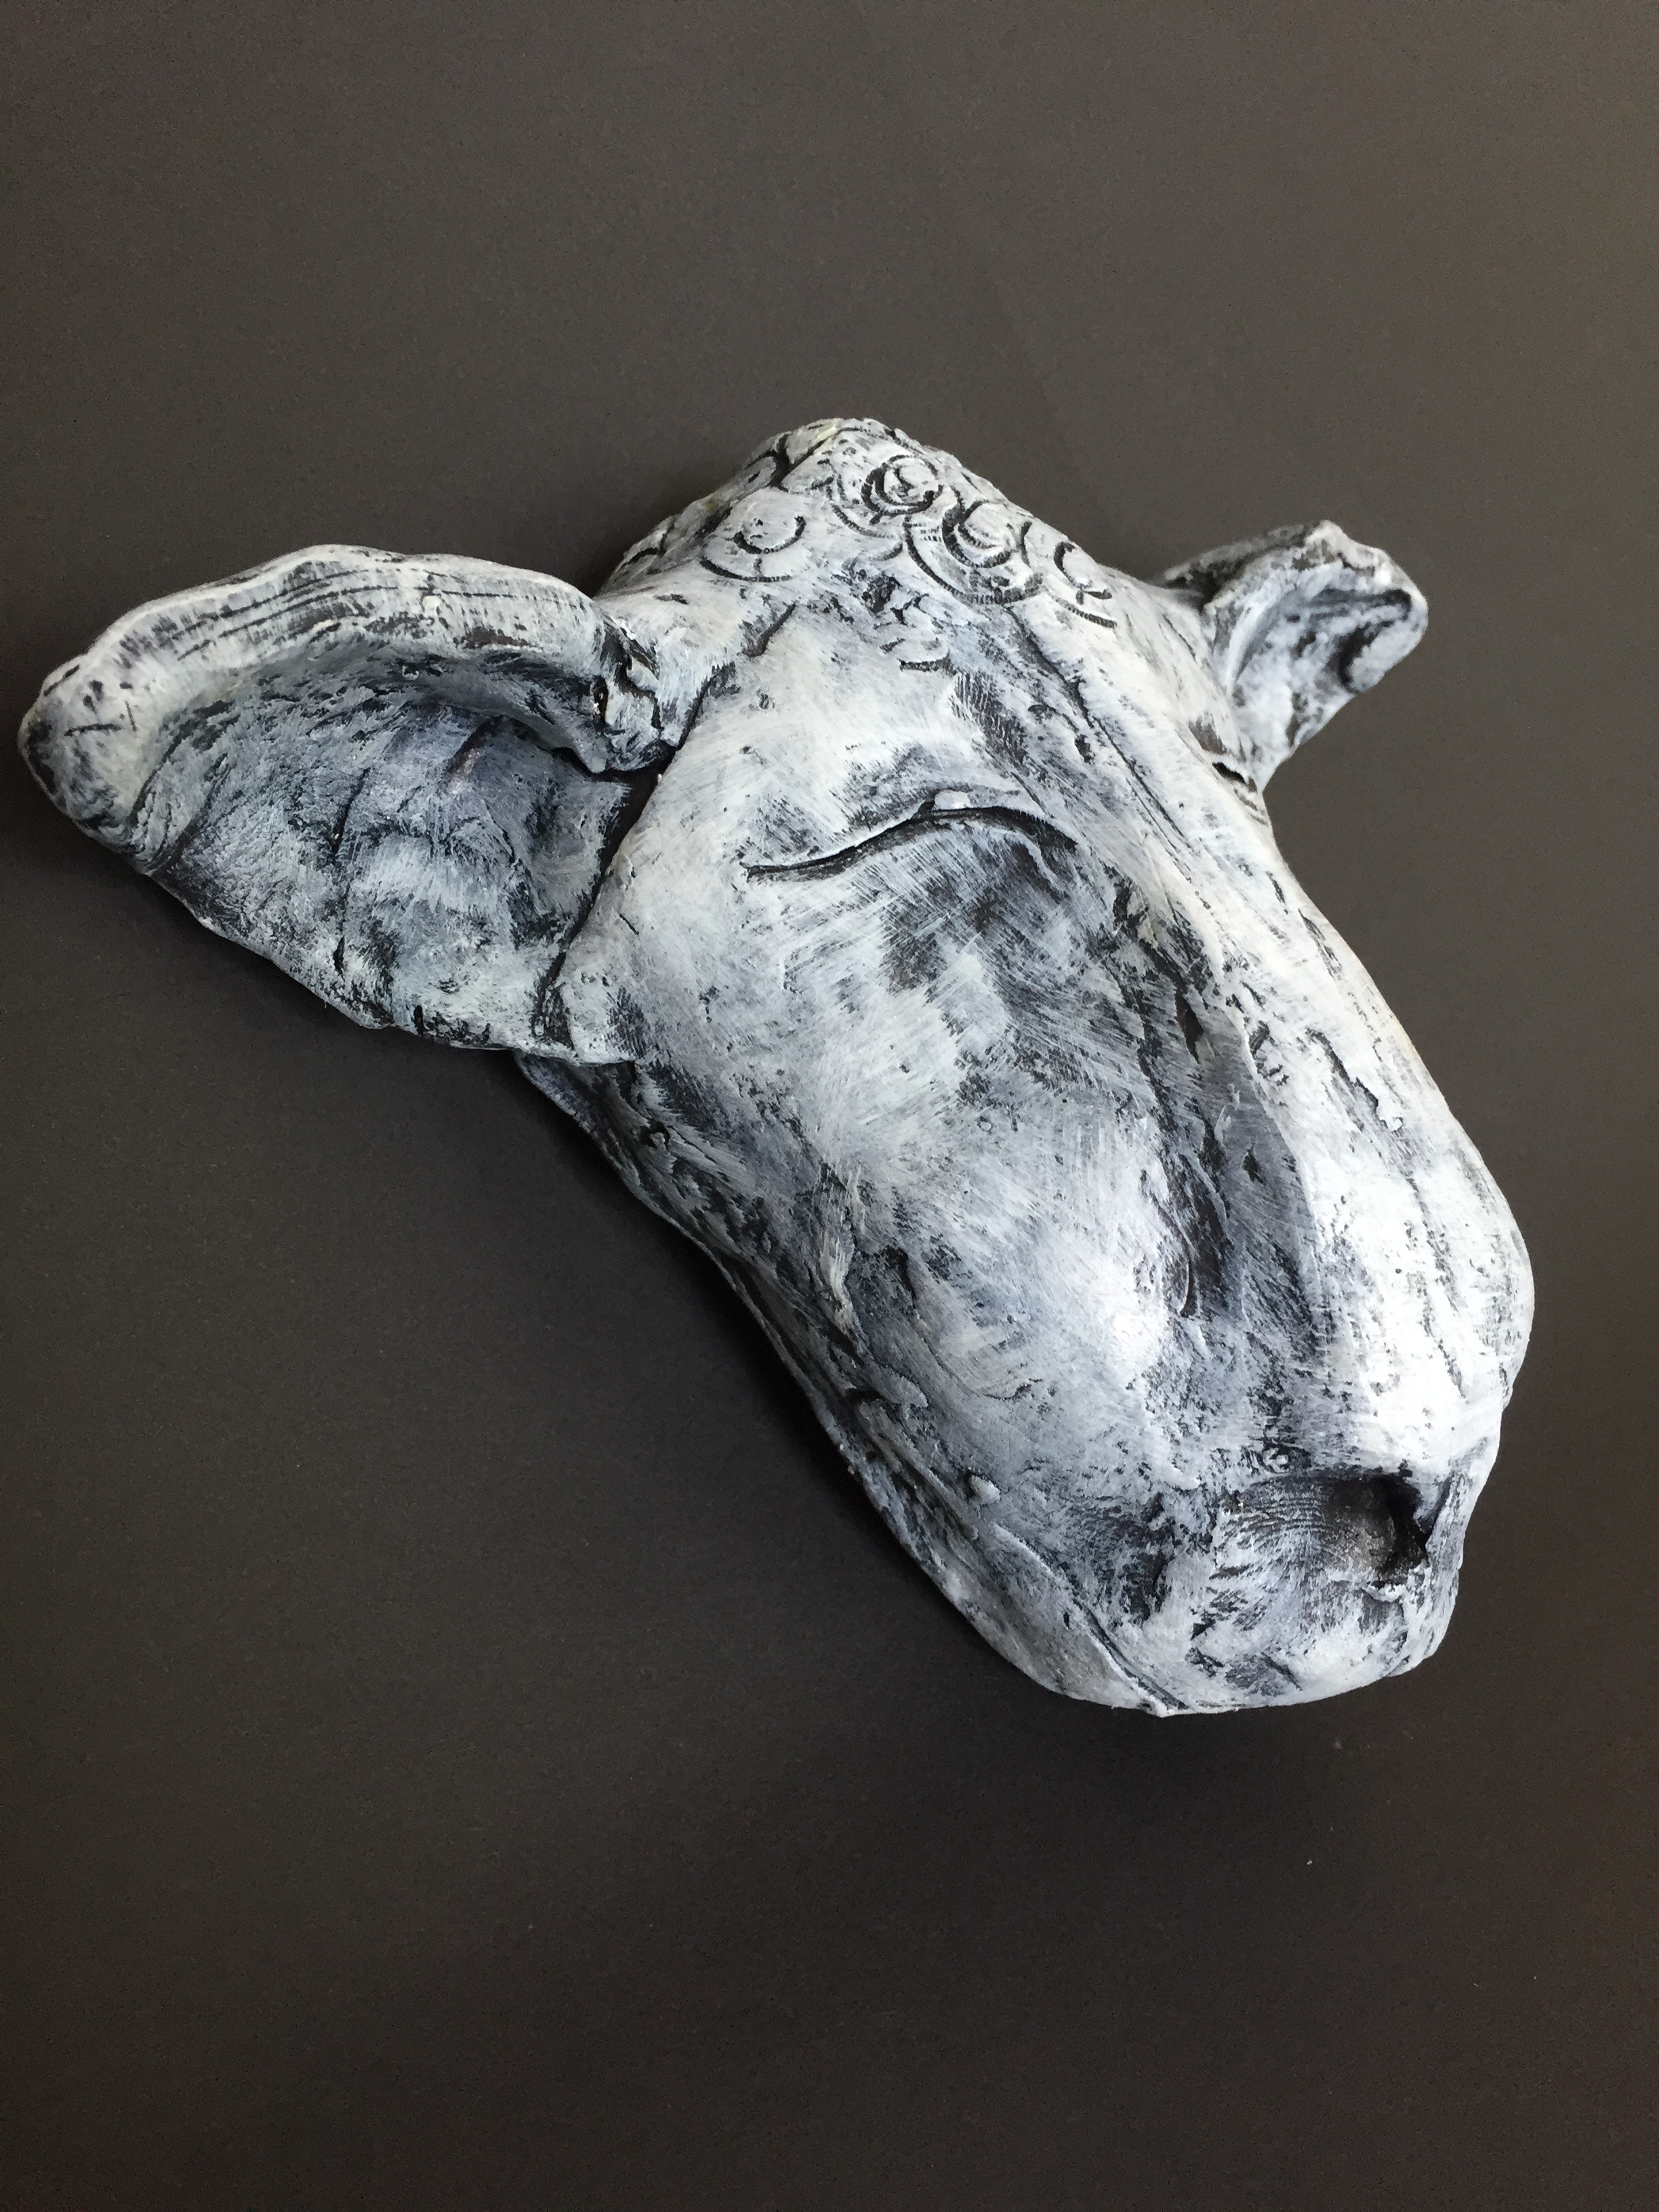
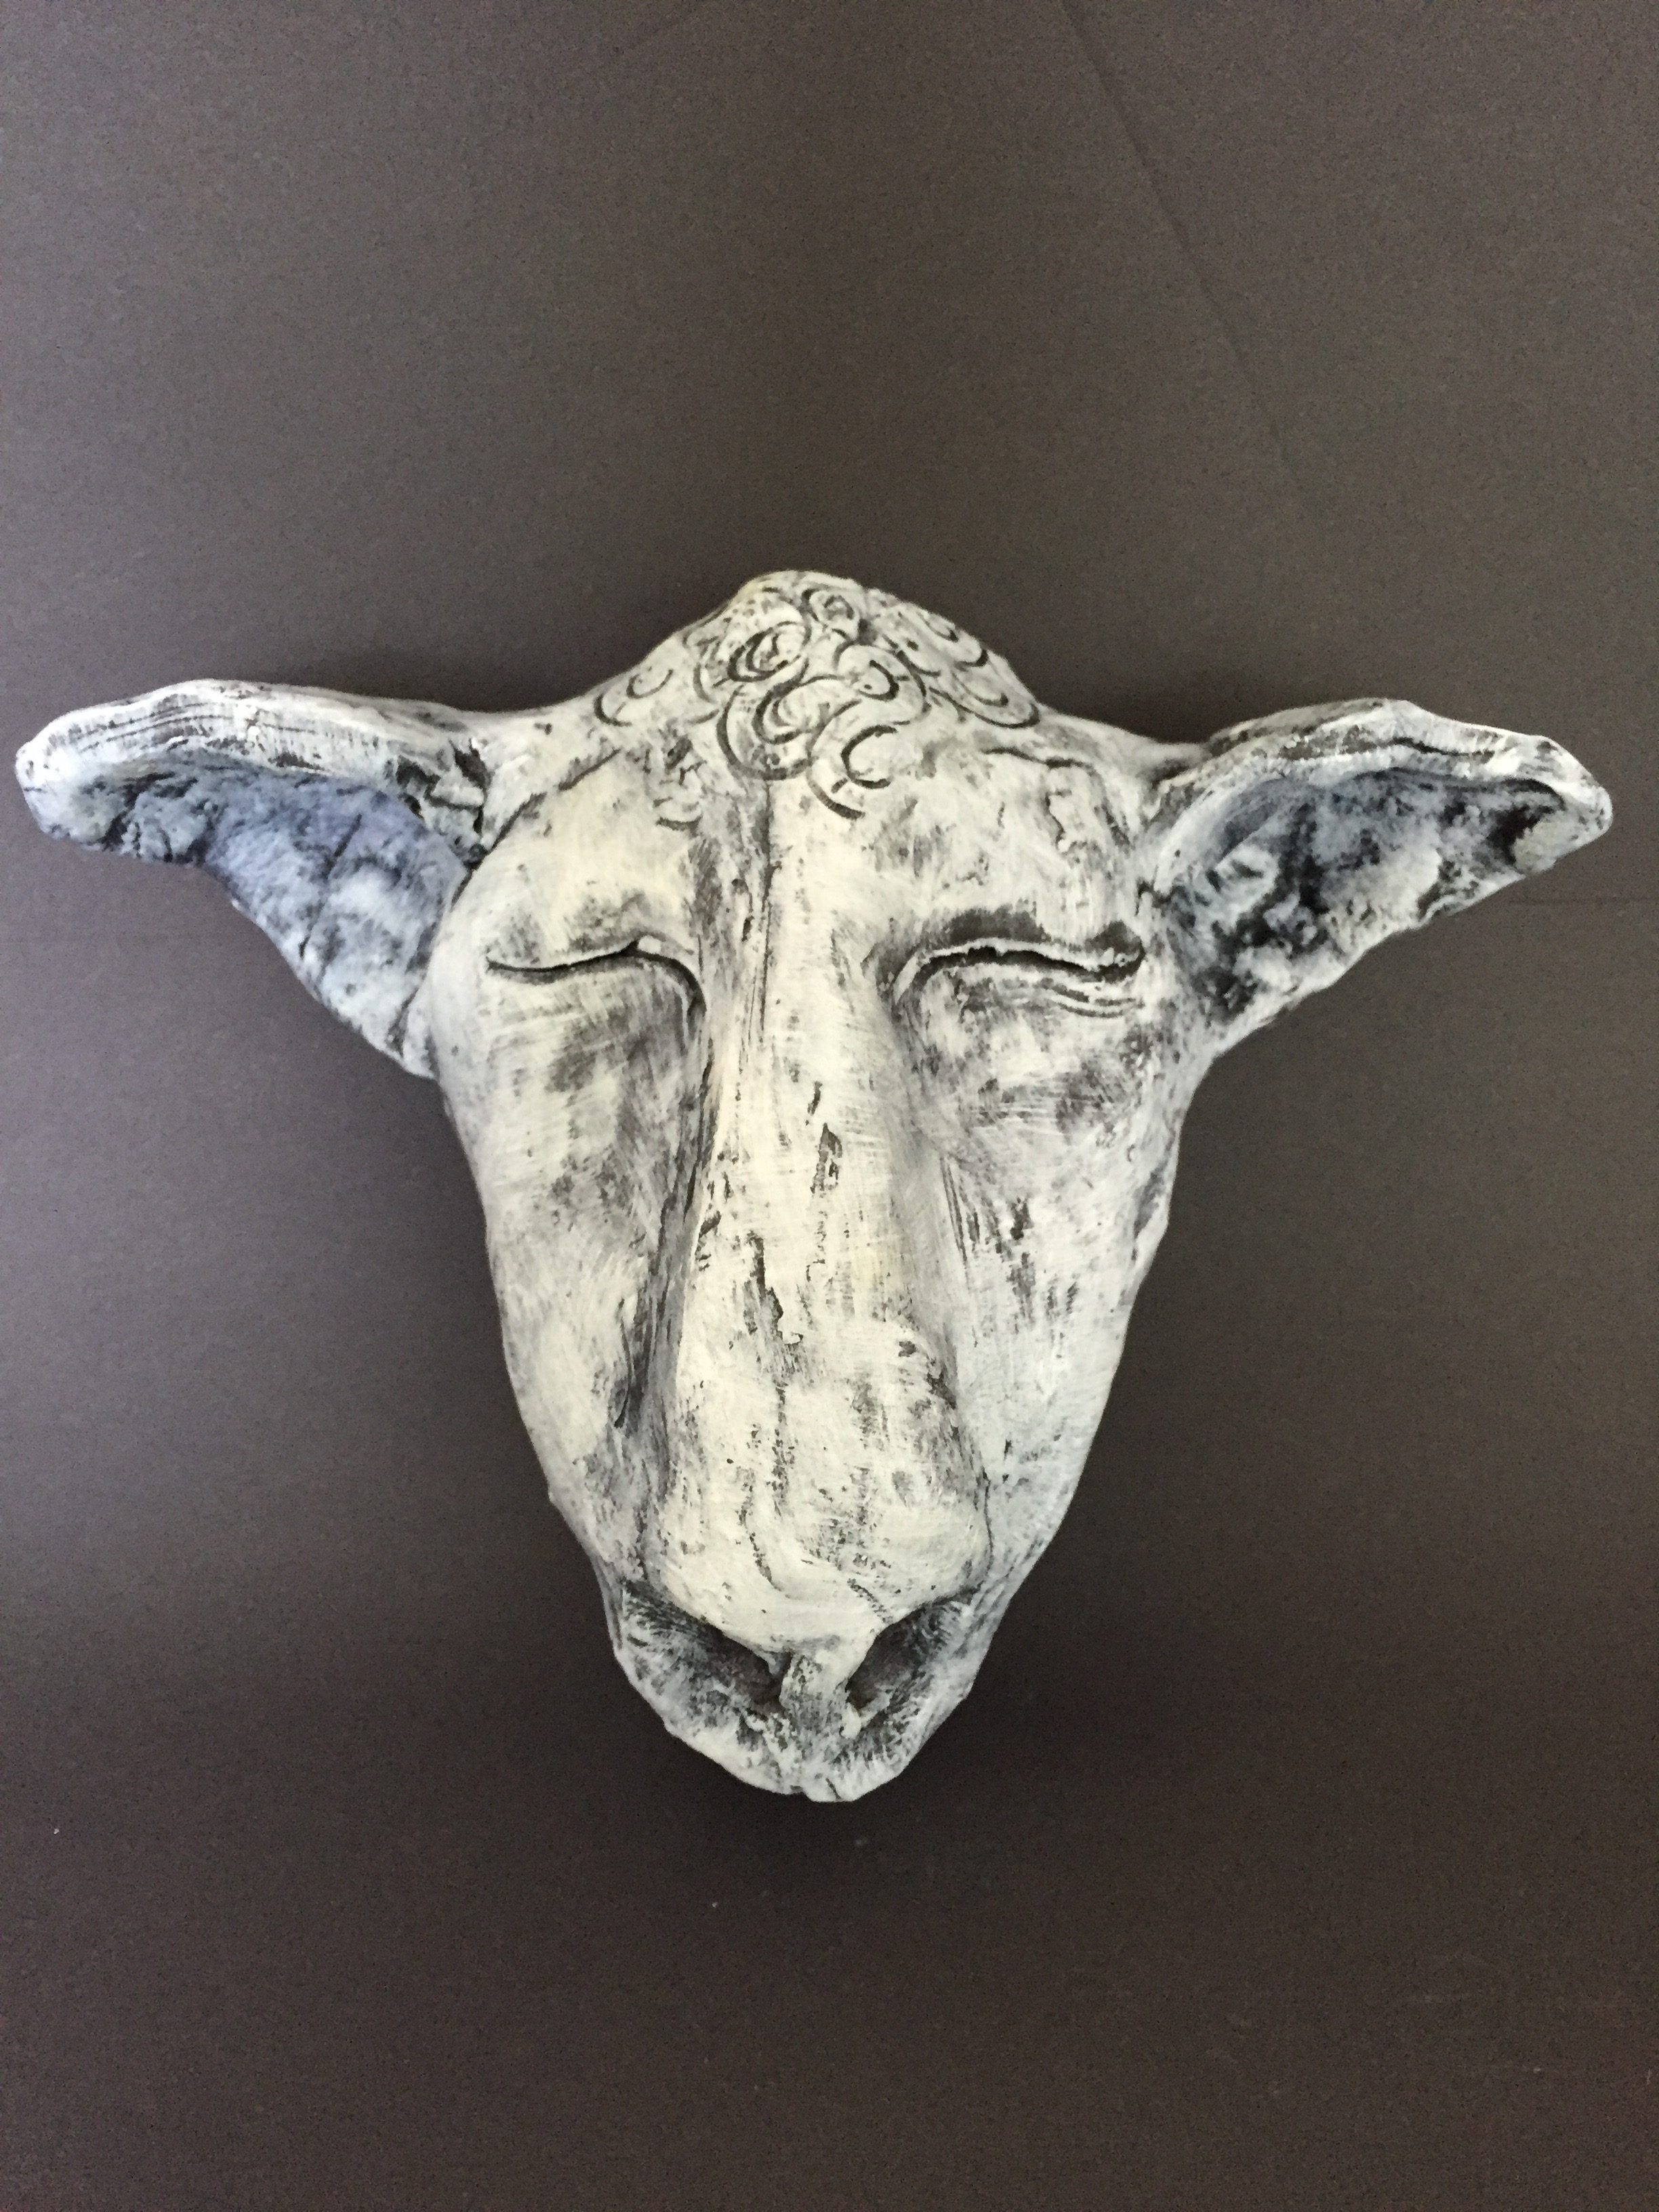
Carl the Sheep, the purveyor of sleep, he infiltrates your dreams with black magic. Call him when you’re wandering, endlessly pondering, and he’ll carry you out into the deep. 2015

Slide 13
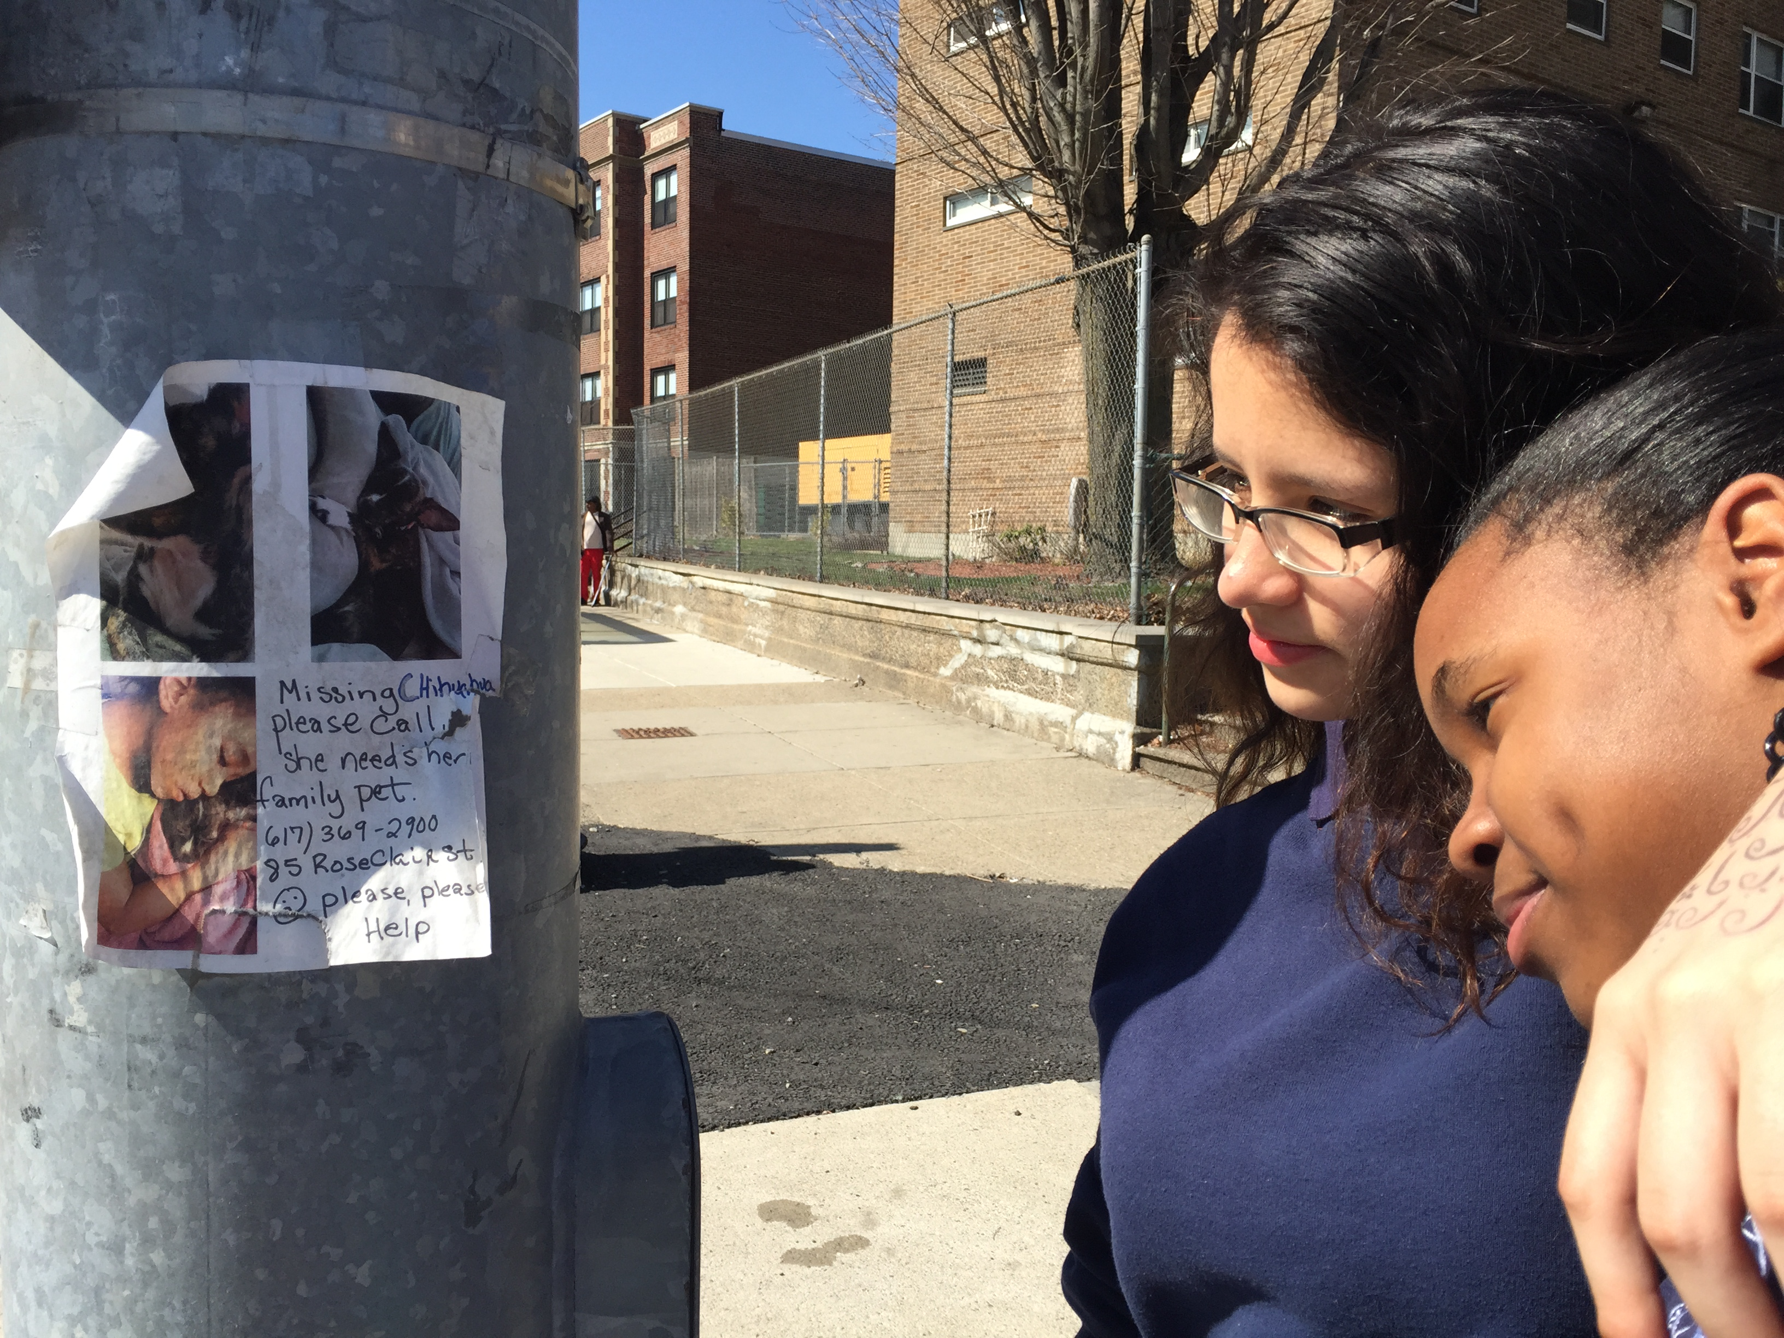
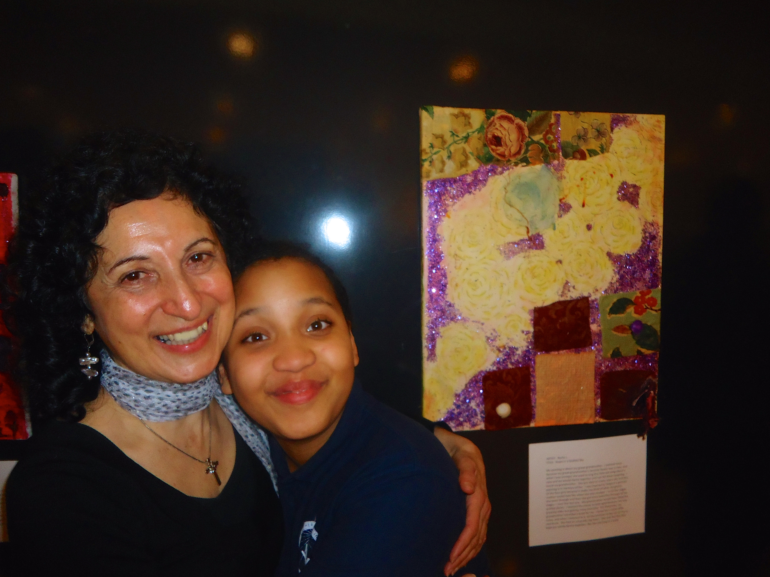
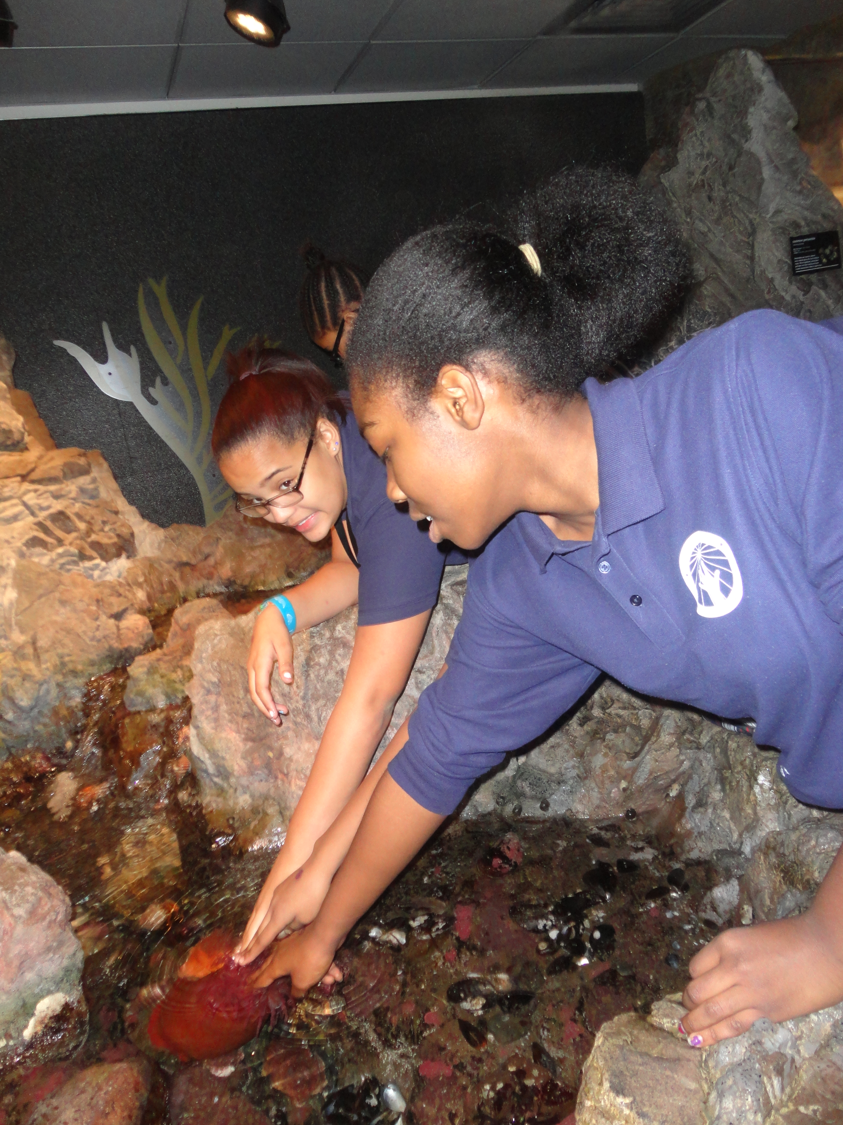
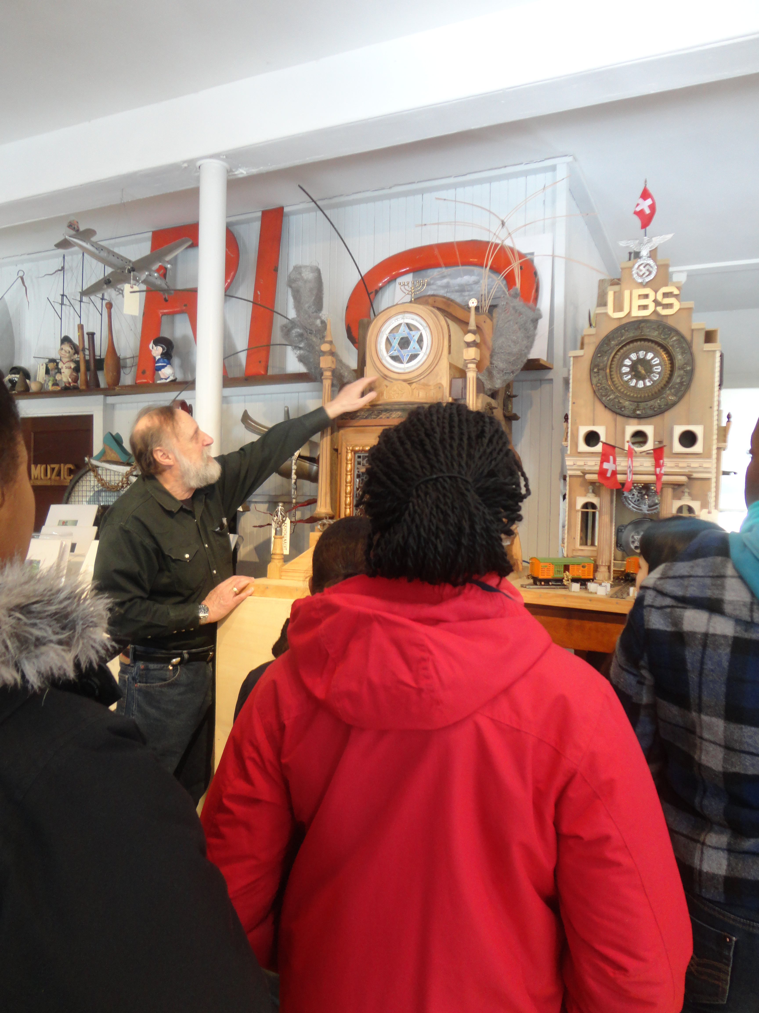
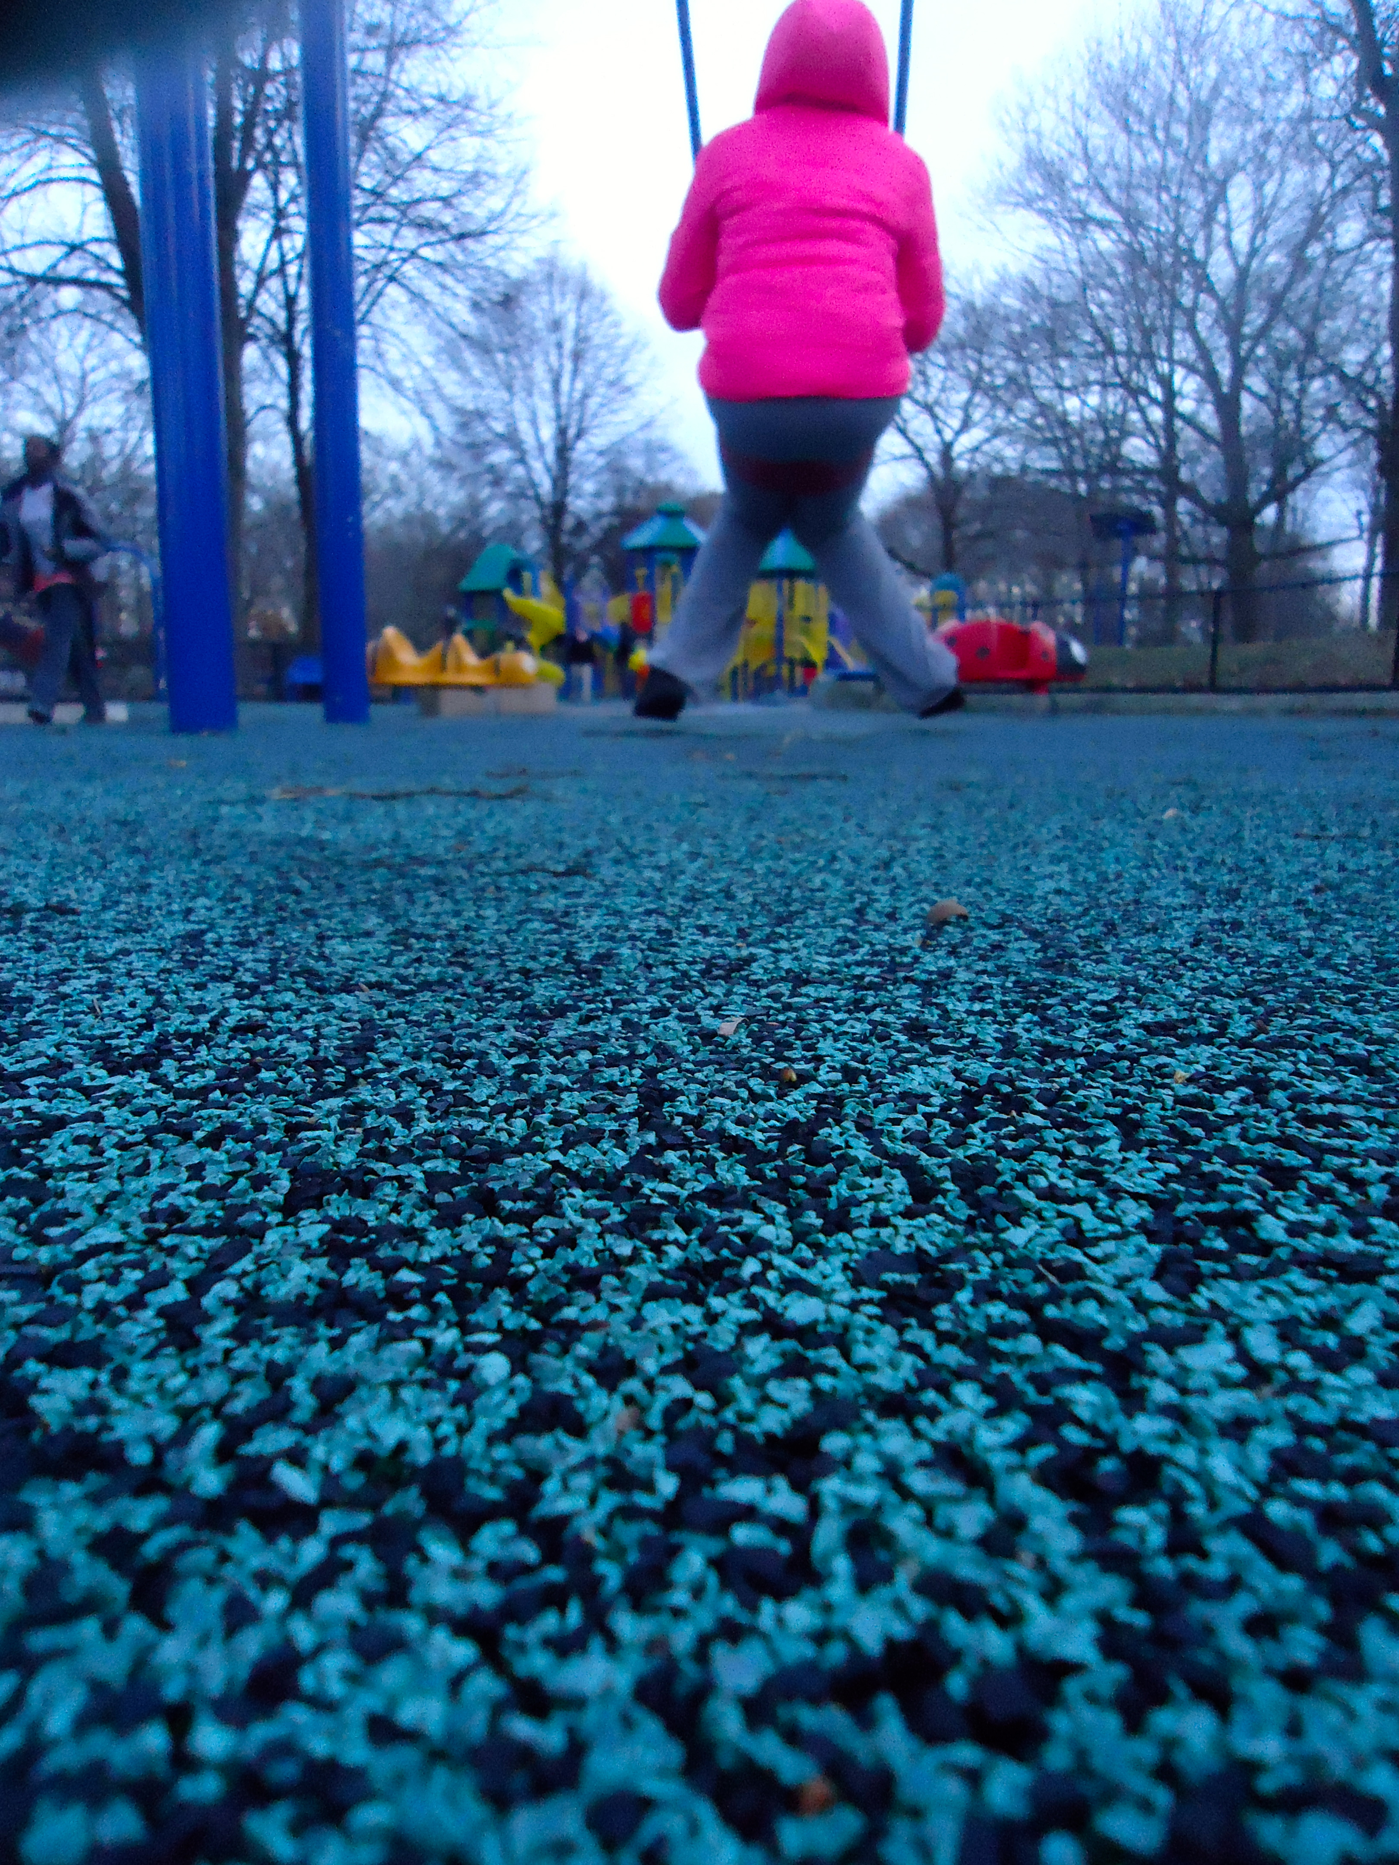
Investment in the community

Slide 14
I am studying art-based inquiry rooted in an understanding of “place” because I want to find out how this methodology can increase student attentiveness, curiosity and investment in their environment; in order to help my reader understand why this system of learning should exist in current educational practices.

